Slide 1
CAP-790
Unit - III

Slide 2
Access Control Matrix
In computer science, an Access Control Matrix or Access Matrix is an abstract, formal security model of protection state in computer systems, that characterizes the rights of each subject with respect to every object in the system. It was first introduced by Butler W. Lampson in 1971.

Slide 3
Continue..
An access matrix can be envisioned as a rectangular array of cells, with one row per subject and one column per object. The entry in a cell – that is, the entry for a particular subject-object pair – indicates the access mode that the subject is permitted to exercise on the object. Each column is equivalent to an access control list for the object; and each row is equivalent to an access profile for the subject.

Slide 4
Definition
According to the model, the protection state of a computer system can be abstracted as a set of objects O, that is the set of entities that needs to be protected (e.g. processes, files, memory pages) and a set of subjects S, that consists of all active entities (e.g. users, processes).
Further there exists a set of rights R of the form r(s,o). A right thereby specifies the kind of access a subject is allowed to process object.

Slide 5
Continue..
Asset 1 | Asset 2 | File | Device
Role 1 | read, write, execute, own | execute | read | write
Role 2 | read | read, write, execute, own

Slide 6
Utility
Because it does not define the granularity of protection mechanisms, the Access Control Matrix can be used as a model of the static access permissions in any type of access control system.
It does not model the rules by which permissions can change in any particular system, and therefore only gives an incomplete description of the system's access control security policy.

Slide 7
Continue..
An Access Control Matrix should be thought of only as an abstract model of permissions at a given point in time; a literal implementation of it as a two-dimensional array would have excessive memory requirements.
Capability-based security and access control lists are categories of concrete access control mechanisms whose static permissions can be modeled using Access Control Matrices.

Slide 8
Continue..
Although these two mechanisms have sometimes been presented (for example in Butler Lampson's Protection paper) as simply row-based and column-based implementations of the Access Control Matrix, this view has been criticized as drawing a misleading equivalence between systems that does not take into account dynamic behaviour.

Slide 9
What Is Authentication?
Authentication is the process of identifying users that request access to a system, network, or device.
Access control often determines user identity according to credentials like username and password.
Other authentication technologies like biometrics and authentication apps are also used to authenticate user identity.

Slide 10
Why Is User Authentication Important?
User authentication is a method that keeps unauthorized users from accessing sensitive information. For example, User A only has access to relevant information and cannot see the sensitive information of User B.
Cybercriminals can gain access to a system and steal information when user authentication is not secure. The data breaches companies like Adobe, Equifax, and Yahoo faced are examples of what happens when organizations fail to secure their user authentication.

Slide 11
Continue..
Hackers gained access to Yahoo user accounts to steal contacts, calendars and private emails between 2012 and 2016. The Equifax data breach in 2017 exposed credit card data of more than 147 million consumers. Without a secure authentication process, any organization could be at risk.

Slide 12
5 Common Authentication Types
Cybercriminals always improve their attacks. As a result, security teams are facing plenty of authentication-related challenges.
This is why companies are starting to implement more sophisticated incident response strategies, including authentication as part of the process.
The list below reviews some common authentication methods used to secure modern systems.

Slide 13
1. Password-based authentication
Passwords are the most common methods of authentication. Passwords can be in the form of a string of letters, numbers, or special characters. To protect yourself you need to create strong passwords that include a combination of all possible options.
However, passwords are prone to phishing attacks and bad hygiene that weakens effectiveness. An average person has about 25 different online accounts, but only 54% of users use different passwords across their accounts.

Slide 14
Continue..
The truth is that there are a lot of passwords to remember. As a result, many people choose convenience over security. Most people use simple passwords instead of creating reliable passwords because they are easier to remember.
The bottom line is that passwords have a lot of weaknesses and are not sufficient in protecting online information. Hackers can easily guess user credentials by running through all possible combinations until they find a match.

Slide 15
2. Multi-factor authentication
Multi-factor Authentication is an authentication method that requires two or more independent ways to identify a user. Examples include codes generated from the user’s smartphone, Captcha tests, fingerprints, voice biometrics or facial recognition.
MFA authentication methods and technologies increase the confidence of users by adding multiple layers of security. MFA may be a good defense against most account hacks, but it has its own pitfalls. People may lose their phones or SIM cards and not be able to generate an authentication code.

Slide 16
3. Certificate-based authentication
Certificate-based authentication technologies identify users, machines or devices by using digital certificates. A digital certificate is an electronic document based on the idea of a driver’s license or a passport.
The certificate contains the digital identity of a user including a public key, and the digital signature of a certification authority. Digital certificates prove the ownership of a public key and issued only by a certification authority.
Users provide their digital certificates when they sign in to a server. The server verifies the credibility of the digital signature and the certificate authority. The server then uses cryptography to confirm that the user has a correct private key associated with the certificate.

Slide 17
4. Biometric authentication
Biometrics authentication is a security process that relies on the unique biological characteristics of an individual. Here are key advantages of using biometric authentication technologies:
Biological characteristics can be easily compared to authorized features saved in a database.
Biometric authentication can control physical access when installed on gates and doors.
You can add biometrics into your multi-factor authentication process.

Slide 18
5. Token-based authentication
Token-based authentication technologies enable users to enter their credentials once and receive a unique encrypted string of random characters in exchange.
You can then use the token to access protected systems instead of entering your credentials all over again.
The digital token proves that you already have access permission. Use cases of token-based authentication include RESTful APIs that are used by multiple frameworks and clients.

Slide 19
User authentication elements
You can view the types of elements used for configuring user authentication and directory services and the element descriptions.
Authentication Methods: Configured authentication methods for end-user and administrator authentication. Used in rules that require end-user authentication.
Servers: Active Directory Servers, LDAP Servers, RADIUS Authentication Servers, and TACACS+ Authentication Servers for end-user and administrator authentication and directory services.
Users: End users stored in the internal LDAP database or an external LDAP database. Used in rules that require end-user authentication.

Slide 20
Other Elements
SMTP Servers SMTP servers that send email or SMS messages about changes to user accounts to end users. The same SMTP Servers can also be used to send Alerts to Administrators.
Certificates Trusted Certificate Authorities that issue certificates presented by service providers, Pending Certificate Requests, and Server Credentials.

Slide 21
Conclusion
Authentication technology is always changing. Businesses have to move beyond passwords and think of authentication as a means of enhancing user experience.
Authentication methods like biometrics eliminate the need to remember long and complex passwords.
As a result of enhanced authentication methods and technologies, attackers will not be able to exploit passwords, and a data breach will be prevented.

Slide 22
Security Models
A computer security model is a scheme for specifying and enforcing security policies.
A security model may be founded upon a formal model of access rights, a model of computation, a model of distributed computing, or no particular theoretical grounding at all.
A computer security model is implemented through a computer security policy.
These models are used for maintaining goals of security, i.e. Confidentiality, Integrity, and Availability. In simple words, it deals with CIA Triad maintenance. There are 3 main types of Classic Security Models.

Slide 23
1. Bell-LaPadula
This Model was invented by Scientists David Elliot Bell and Leonard .J. LaPadula. Thus this model is called the Bell-LaPadula Model. This is used to maintain the Confidentiality of Security.
Here, the classification of Subjects(Users) and Objects(Files) are organized in a non-discretionary fashion, with respect to different layers of secrecy.

Slide 24
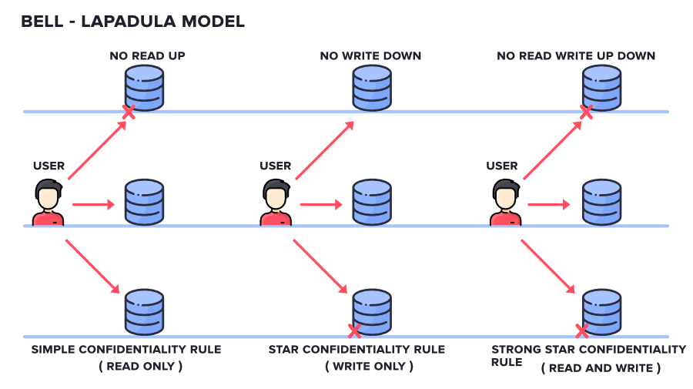
Continue..

Slide 25
Continue..
SIMPLE CONFIDENTIALITY RULE: Simple Confidentiality Rule states that the Subject can only Read the files on the Same Layer of Secrecy and the Lower Layer of Secrecy but not the Upper Layer of Secrecy, due to which we call this rule as NO READ-UP
STAR CONFIDENTIALITY RULE: Star Confidentiality Rule states that the Subject can only Write the files on the Same Layer of Secrecy and the Upper Layer of Secrecy but not the Lower Layer of Secrecy, due to which we call this rule as NO WRITE-DOWN

Slide 26
Continue..
STRONG STAR CONFIDENTIALITY RULE: Stong Star Confidentiality Rule is highly secured and strongest which states that the Subject can Read and Write the files on the Same Layer of Secrecy only and not the Upper Layer of Secrecy or the Lower Layer of Secrecy, due to which we call this rule as NO READ WRITE UP DOWN

Slide 27
2. Biba
This Model was invented by Scientist Kenneth .J. Biba. Thus this model is called Biba Model. This is used to maintain the Integrity of Security.
Here, the classification of Subjects(Users) and Objects(Files) are organized in a non-discretionary fashion, with respect to different layers of secrecy.
This works the exact reverse of the Bell-LaPadula Model.

Slide 28
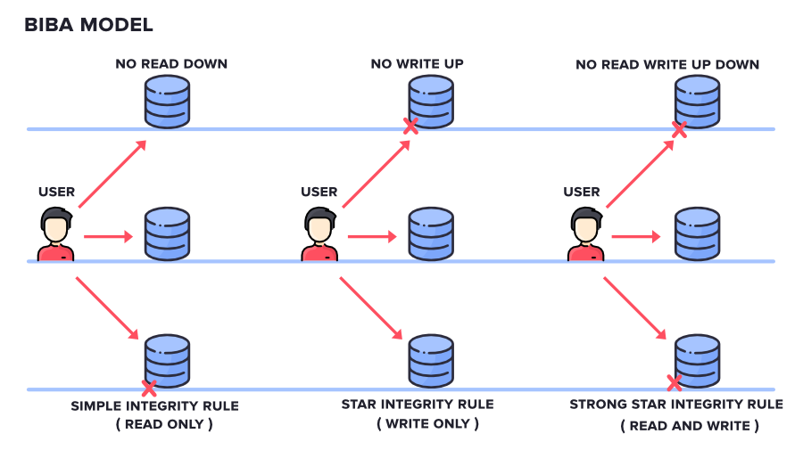
Continue..

Slide 29
It has mainly 3 Rules:
SIMPLE INTEGRITY RULE: Simple Integrity Rule states that the Subject can only Read the files on the Same Layer of Secrecy and the Upper Layer of Secrecy but not the Lower Layer of Secrecy, due to which we call this rule as NO READ DOWN
STAR INTEGRITY RULE: Star Integrity Rule states that the Subject can only Write the files on the Same Layer of Secrecy and the Lower Layer of Secrecy but not the Upper Layer of Secrecy, due to which we call this rule as NO WRITE-UP
STRONG STAR INTEGRITY RULE

Slide 30
3. Clarke Wilson Security Model
This Model is a highly secured model. It has the following entities.
SUBJECT: It is any user who is requesting for Data Items.
CONSTRAINED DATA ITEMS: It cannot be accessed directly by the Subject. These need to be accessed via Clarke Wilson Security Model
UNCONSTRAINED DATA ITEMS: It can be accessed directly by the Subject.

Slide 31
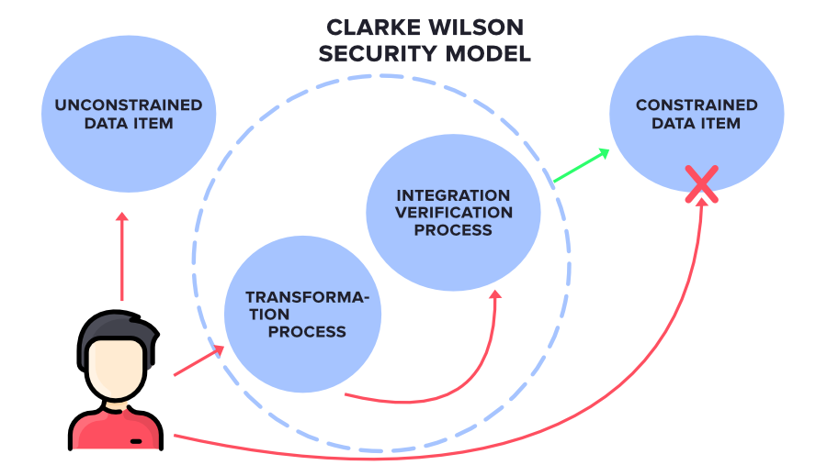
Continue..

Slide 32
The Components of Clarke Wilson Security Model
TRANSFORMATION PROCESS: Here, the Subject’s request to access the Constrained Data Items is handled by the Transformation process which then converts it into permissions and then forwards it to Integration Verification Process
INTEGRATION VERIFICATION PROCESS: The Integration Verification Process will perform Authentication and Authorization. If that is successful, then the Subject is given access to Constrained Data Items.

Slide 33
Disaster Recovery
Disaster Recovery involves a set of policies, tools and procedures to enable the recovery or continuation of vital technology infrastructure and systems following a natural or human-induced disaster.
Disaster recovery focuses on the IT or technology systems supporting critical business functions, as opposed to business continuity, which involves keeping all essential aspects of a business functioning despite significant disruptive events. Disaster recovery can therefore be considered a subset of business continuity.

Slide 34
Continue..
Disaster Recovery assumes that the primary site is not recoverable (at least for some time) and represents a process of restoring data and services to a secondary survived site, which is opposite to the process of restoring back to its original place.

Slide 35
How does disaster recovery work?
Disaster recovery relies upon the replication of data and computer processing in an off-premises location not affected by the disaster.
When servers go down because of a natural disaster, equipment failure or cyber attack, a business needs to recover lost data from a second location where the data is backed up.
Ideally, an organization can transfer its computer processing to that remote location as well in order to continue operations.

Slide 36
IT Service Continuity
IT Service Continuity (ITSC) is a subset of business continuity planning (BCP) and encompasses IT disaster recovery planning and wider IT resilience planning. It also incorporates those elements of IT infrastructure and services which relate to communications such as (voice) telephony and data communications.
The ITSC Plan reflects Recovery Point Objective (RPO - recent transactions) and Recovery Time Objective (RTO - time intervals).

Slide 37
Recovery Time Objective
The Recovery Time Objective (RTO) is the targeted duration of time and a service level within which a business process must be restored after a disaster (or disruption) in order to avoid unacceptable consequences associated with a break in business continuity.
Schematic representation of the terms RPO and RTO. In this example, the agreed values of RPO and RTO are not fulfilled.
In accepted business continuity planning methodology, the RTO is established during the Business Impact Analysis (BIA) by the owner of a process, including identifying options time frames for alternate or manual workarounds.

Slide 38
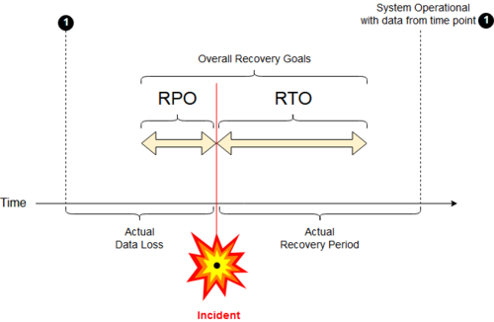
Continue..

Slide 39
Recovery Point Objective
A Recovery Point Objective (RPO) is defined by business continuity planning. It is the maximum targeted period in which data (transactions) might be lost from an IT service due to a major incident.
If RPO is measured in minutes (or even a few hours), then in practice, off-site mirrored backups must be continuously maintained; a daily off-site backup on tape will not suffice.

Slide 40
5 top elements of an effective disaster recovery plan
Disaster recovery team: This assigned group of specialists will be responsible for creating, implementing and managing the disaster recovery plan. This plan should define each team member’s role and responsibilities. In the event of a disaster, the recovery team should know how to communicate with each other, employees, vendors, and customers.
Risk evaluation: Assess potential hazards that put your organization at risk. Depending on the type of event, strategize what measures and resources will be needed to resume business. For example, in the event of a cyber attack, what data protection measures will the recovery team have in place to respond?

Slide 41
Continue..
Business-critical asset identification: A good disaster recovery plan includes documentation of which systems, applications, data, and other resources are most critical for business continuity, as well as the necessary steps to recover data.
Backups: Determine what needs backup (or to be relocated), who should perform backups, and how backups will be implemented. Include a recovery point objective (RPO) that states the frequency of backups and a recovery time objective (RTO) that defines the maximum amount of downtime allowable after a disaster.

Slide 42
Continue..
Testing and optimization: The recovery team should continually test and update its strategy to address ever-evolving threats and business needs.
By continually ensuring that a company is ready to face the worst-case scenarios in disaster situations, it can successfully navigate such challenges.
In planning how to respond to a cyber attack, for example, it’s important that organizations continually test and optimize their security and data protection strategies and have protective measures in place to detect potential security breaches.

Slide 43
How to build a disaster recovery team?
Whether creating a disaster recovery strategy from scratch or improving an existing plan, assembling the right collaborative team of experts is a critical first step. It starts with tapping IT specialists and other key individuals to provide leadership over the following key areas in the event of a disaster:

Slide 44
Continue..
Crisis management: This leadership role commences recovery plans, coordinates efforts throughout the recovery process, and resolves problems or delays that emerge.
Business continuity: The expert overseeing this ensures that the recovery plan aligns with the company’s business needs, based on the business impact analysis.
Impact assessment and recovery: The team responsible for this area of recovery has technical expertise in IT infrastructure including servers, storage, databases and networks.
IT applications: This role monitors which application activities should be implemented based on a restorative plan. Tasks include application integrations, application settings and configuration, and data consistency.

Slide 45
Trusted computing and Multilevel Security
Multilevel security or multiple levels of security (MLS) is the application of a computer system to process information with incompatible classifications (i.e., at different security levels), permit access by users with different security clearances and needs-to-know, and prevent users from obtaining access to information for which they lack authorization.

Slide 46
Two contexts for the use of multilevel security.
One is to refer to a system that is adequate to protect itself from subversion and has robust mechanisms to separate information domains, that is, trustworthy.
Another context is to refer to an application of a computer that will require the computer to be strong enough to protect itself from subversion and possess adequate mechanisms to separate information domains, that is, a system we must trust.
This distinction is important because systems that need to be trusted are not necessarily trustworthy.

Slide 47
Trusted operating systems
An MLS operating environment often requires a highly trustworthy information processing system often built on an MLS operating system (OS), but not necessarily.
Most MLS functionality can be supported by a system composed entirely of untrusted computers, although it requires multiple independent computers linked by hardware security-compliant channels.

Slide 48
Continue..
An example of hardware enforced MLS is asymmetric isolation. If one computer is being used in MLS mode, then that computer must use a trusted operating system (OS).
Because all information in an MLS environment is physically accessible by the OS, strong logical controls must exist to ensure that access to information is strictly controlled.
Typically this involves mandatory access control that uses security labels, like the Bell–LaPadula model.

Slide 49
Continue..
Freely available operating systems with some features that support MLS include Linux with the Security-Enhanced Linux feature enabled and FreeBSD. Security evaluation was once thought to be a problem for these free MLS implementations for three reasons:

Slide 50
Continue..
It is always very difficult to implement kernel self-protection strategy with the precision needed for MLS trust, and these examples were not designed to or certified to an MLS protection profile so they may not offer the self-protection needed to support MLS.
Common Criteria lacks an inventory of appropriate high assurance protection profiles that specify the robustness needed to operate in MLS mode.
Even if (1) and (2) were met, the evaluation process is very costly and imposes special restrictions on configuration control of the evaluated software.

Slide 51
Problem areas
Sanitization is a problem area for MLS systems. Systems that implement MLS restrictions, like those defined by Bell–LaPadula model, only allow sharing when it does not obviously violate security restrictions.
Users with lower clearances can easily share their work with users holding higher clearances, but not vice versa.
There is no efficient, reliable mechanism by which a Top Secret user can edit a Top Secret file, remove all Top Secret information, and then deliver it to users with Secret or lower clearances.

Slide 52
Continue..
Covert channels pose another problem for MLS systems. For an MLS system to keep secrets perfectly, there must be no possible way for a Top Secret process to transmit signals of any kind to a Secret or lower process.
This includes side effects such as changes in available memory or disk space, or changes in process timing. When a process exploits such a side effect to transmit data, it is exploiting a covert channel.
It is extremely difficult to close all covert channels in a practical computing system, and it may be impossible in practice. The process of identifying all covert channels is a challenging one by itself.

Slide 53
Continue..
Bypass is problematic when introduced as a means to treat a system high object as if it were MLS trusted. A common example is to extract data from a secret system high object to be sent to an unclassified destination, citing some property of the data as trusted evidence that it is 'really' unclassified (e.g. 'strict' format).
A system high system cannot be trusted to preserve any trusted evidence, and the result is that an overt data path is opened with no logical way to securely mediate it.

Slide 54
MILS architecture
Multiple Independent Levels of Security (MILS) is an architecture that addresses the domain separation component of MLS.
Security models such as the Biba model (for integrity) and the Bell–LaPadula model (for confidentiality) allow one-way flow between certain security domains that are otherwise assumed to be isolated.
MILS addresses the isolation underlying MLS without addressing the controlled interaction between the domains addressed by the above models.

Slide 55
Continue..
Trusted security-compliant channels mentioned above can link MILS domains to support more MLS functionality.
The MILS approach pursues a strategy characterized by an older term, MSL (multiple single level), that isolates each level of information within its own single-level environment (System High).
The rigid process communication and isolation offered by MILS may be more useful to ultra high reliability software applications than MLS. MILS notably does not address the hierarchical structure that is embodied by the notion of security levels.

Slide 56
MSL systems
There is another way of solving such problems known as multiple single-level.
Each security level is isolated in a separate untrusted domain.
The absence of medium of communication between the domains assures no interaction is possible.
The mechanism for this isolation is usually physical separation in separate computers.
This is often used to support applications or operating systems which have no possibility of supporting MLS such as Microsoft Windows.

